Slide 1

LIB-AI Roadmap
“Imagine a time when computers could only compute numbers—fast forward to today, they can create art, write essays, and even hold conversations that feel human.
This is the power of AI.”
Empowering Tech & Non-Tech Audiences to Leverage AI

Slide 2
AgENDA
Kavitha
Introduction to AI (General)
Overview of the tracks
Breakdown of 3 tracks:
Non-Tech,
ML, and
Foundation Models
Committee introduction
Session details:
Topics,
Timeline,
Deliverables and
Speakers
Key milestones and expectations

Slide 3
LIB-AI Goals and Vision
Kavitha
Vision:
Inclusive Future in Tech
Transforming the narrative around Women in AI
Mentorship and Networking
Encouraging diversity in thought
Goals of these Sessions:
AI - Empowerment through Knowledge :
Bridge the gender gap in the tech industry and create more opportunities for women in tech roles.
simplify complex concepts like AI,ML, Foundation Models:
This helps women feel more confident in engaging with technical topics, which often seem intimidating at first glance.
Building a Supportive Learning Community:
This community-based learning approach can be incredibly powerful, especially in a space like LeanIn, where there is a strong focus on support, mentorship, and empowerment.

Slide 4
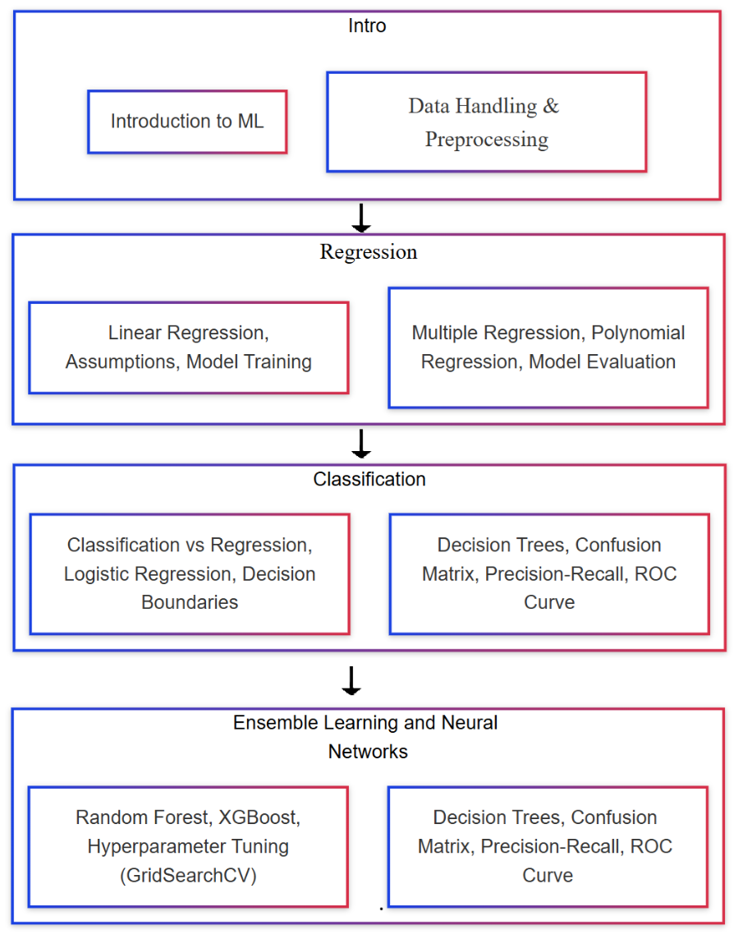
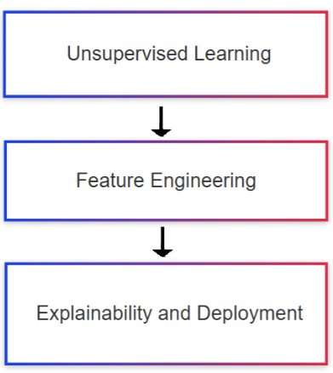
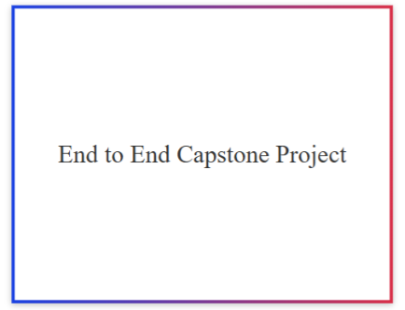
TECH BASIC

Slide 5
Volunteers chart
Kavitha
Name | Profession | Company | LIB-AI-role | Work experience
Kavitha Yogaraj | Senior Quantum Computational Scientist | IBM Research | Co-founder of LIB-AI & lead for Tech track | 14
Khushi | Lead Data Scientist |  | Co-founder of LIB-AI & lead for Tech track
Sohini |  |  | Co-lead for Tech-track
Manashi Ganguly |  |  | Non-tech Lead
Sweta |  |  | Non-tech Co-Lead

Slide 6
Tech Track Session Speakers
Kavitha
To add details by each individuals
Name | Profession | Company | LIB-AI-role | Work experience
Rajesh
Neha
Jamuna
Vaibhavi
Surya Kumari

Slide 7
Organizing & Market Team
Kavitha
Name | Profession | Company | LIB-AI-role | Work experience
Preethi |  |  |  | Lead Co-Ordinator
Ranjini Rao |  |  |  | Lead Digital Marketing
Tejaswini |  |  |  | Digital Marketing
Devansh |  |  |  | Digital Marketing

Slide 8
Introduction to Tracks
Kavitha
Track | Frequency | Total Sessions | Time
Non-Tech Track | Quarterly once | 4 | 1-2 hrs
Tech – ML Track | Every First Saturday of the month | 12 | 2 hrs
Tech – Foundation Models | Every First Saturday of the month | 12 | 2 hrs
Non-Tech Track: Business professionals, product managers, marketers, entrepreneurs, and AI enthusiasts with no or minimal technical background.
Tech – ML Track: Data scientists, software developers, data analysts, and engineers who want to learn about machine learning and its practical applications.
Tech – Foundation Models: AI researchers, advanced data scientists, NLP engineers, and AI/ML engineers with a focus on large-scale language models and deep learning technologies.

Slide 9
Responsibilities of the lead and co-lead for each track.
Overall Project Management:
Ensure that all sessions and topics are aligned with the larger goal of the 12-month project.
Set and communicate deadlines for content preparation, speaker readiness, and any follow-up tasks.
Track the progress of the roadmap, ensuring that the sessions are scheduled, the speakers are prepared, and the content is delivered on time.
Monitor and track participant progress across the sessions
Content & Curriculum Verification:
Ensure the content is comprehensive and consistent across all sessions, integrating real-world applications, mathematical explanations, and practical demonstrations.
Oversee that each speaker follows the structured format (Concept - Application - Mathematical - Notebook) for their respective sessions.
Help speakers by providing guidance on how to break down complex AI concepts into layman’s terms, ensuring clarity for the audience
Speaker Support & Coordination
Act as the main point of contact for each session’s speaker to offer assistance where needed (e.g., PPT creation, demo preparation).
Ensure that all session content is peer-reviewed or checked for consistency before delivery.
Help align the individual speakers with the broader project goals.

Slide 10
Structure of each session
Kavitha
Introduce Concept – PPT – In Layman Terms
Application – Where Can It Be Used?
Mathematical – Explanation
Notebook – Go Through the Notebook with Results

Slide 11
Track Outcomes
Kavitha
Non-Tech Track Learning Outcomes
Business understanding, AI applications, ethical considerations.
ML Track Learning Outcomes
Model building, data handling, model evaluation techniques.
Foundation Model Track Learning Outcomes
Fine-tuning and applying pre-trained models to NLP tasks.
Overall Learning Outcomes
How all tracks contribute to a holistic AI understanding.

Slide 12
Non-Tech Track
Kavitha
Audience:
Business Professionals: Managers, Executives, Product Managers, and anyone in a business role who needs to understand the strategic and practical aspects of AI and its applications without needing deep technical expertise.
Entrepreneurs: Those looking to integrate AI into their business models, products, or services but without deep technical knowledge.
Sales & Marketing Professionals: Individuals in sales, business development, or marketing who need to understand AI to communicate its value to clients or stakeholders.
AI Enthusiasts: People interested in AI but without a technical background who want to understand the fundamentals of how AI is applied in the business world.
Focus Areas:
AI applications in business, marketing, customer service, finance, and operations.
Understanding AI concepts at a high level: what AI can do, its impact on industries, and its ethical considerations.
No deep technical knowledge required.

Slide 13
Tech – ML Track
Kavitha
Audience:
Data Scientists: Professionals with a background in data analysis and statistics looking to dive deeper into machine learning algorithms and techniques.
Software Developers: Developers interested in transitioning to data science and machine learning roles, or those wanting to integrate ML into their existing applications.
Data Analysts: Individuals with strong data-handling skills who want to move into predictive modeling and machine learning.
Engineers: Technical professionals looking to understand and implement machine learning algorithms in real-world problems.
Focus Areas:
Building machine learning models: regression, classification, clustering, ensemble methods, etc.
Techniques for data preprocessing, handling data, and working with machine learning pipelines.
Hands-on with ML tools like Python and Scikit-learn.
Key ML concepts like model evaluation, cross-validation, and hyperparameter tuning.

Slide 14
Tech – Foundation Models (LLMs and NLP)
Kavitha
Audience:
Advanced Data Scientists: Data scientists who have a solid understanding of machine learning and are looking to specialize in deep learning, particularly large language models (LLMs) and other foundational models.
NLP Engineers: Professionals specifically working in Natural Language Processing, text generation, and conversational AI who want to deepen their expertise in LLMs.
AI/ML Engineers: Engineers looking to design, deploy, or optimize large-scale AI systems based on foundation models.
Focus Areas:
Understanding foundation models (e.g., GPT, BERT, T5) and their architectures.
Fine-tuning pre-trained models for NLP tasks: sentiment analysis, summarization, translation, etc.
Deep learning, transformers, attention mechanisms, and state-of-the-art NLP techniques.
Scaling LLMs and deploying them in real-world applications, focusing on the nuances of model performance, resource consumption, and operational challenges.

Slide 15
Sessions | Main | Topics covered | Speaker name
1 | Introduction to ML | What is ML? Types of ML, ML pipeline, Applications | Kavitha
2 | Data Handling & Preprocessing | Data types, Pandas, Data Cleaning, Feature Scaling, Encoding , power BI | Vaibhavi
3 | Model Training | Model Training | Rajesh
4 | Regression | Linear Regression, Assumptions, Model Evaluation (RMSE, R²) | Vaibhavi
5 | Classification | Classification vs Regression, Logistic Regression, Decision Boundaries
6 | Classification | Decision Trees, Confusion Matrix, Precision-Recall, ROC Curve | Neha
7 | Ensemble & Tuning | Ensemble Learning (Random Forest, XGBoost), Hyperparameter Tuning (GridSearchCV) | Neha
8 | Unsupervised Learning | Clustering (K-Means, Hierarchical), PCA | Jamuna
9 | Feature Engineering | Feature Selection, Feature Engineering, Bias-Variance Tradeoff | Jamuna
10 | Deployment | ML operations pipeline & Model Deployment | Rajesh
11-12 | Capstone Project | End-to-End Capstone Project | Kavitha
Kavitha

Slide 16
Tools and Technologies
Kavitha
Tools for Data Handling and Preprocessing
Python, Pandas, Numpy, Power BI.
Tools for Machine Learning
TensorFlow, Keras, Scikit-learn.
Tools for NLP and LLMs
HuggingFace, SpaCy, GPT, BERT.
Cloud Tools for Deployment
AWS, Azure, Google Cloud.

Slide 17
Success Stories and Case Studies
Kavitha
ML Success Stories
Use cases where machine learning models have made a significant impact.
Impact of Capstone Projects
Showcase 10 sessions by building end to end project and deploy

Slide 18
Overview
Designed to bridge the gap between AI concepts and practical implementations.
We will be working with
Large Language Models (LLMs)
Retrieval-Augmented Generation (RAG)
NLP models,
Reinforcement learning
AI deployment strategies.

Slide 19
Who Should Join
AI enthusiasts, developers, and professionals looking to deepen their practical AI skills.
Anyone with basic Python programming knowledge
Experience with NumPy, Pandas, or ML libraries is helpful but not mandatory
General understanding of AI concepts find the sessions easier to follow.

Slide 20
What to Expect?
Hands-on coding
Real-world applications
Guided learning: Step-by-step implementations
Capstone Projects

Slide 21
EXPECTED TECH STACKs
Python IDEs
Google-Colab, Kaggle Notebooks, Paperspace etc.
AI Studios and Platforms
Google Vertex AI & AI Studio
Hugging Face Inference API
AWS Bedrock
Lightning AI
Vector Stores
FAISS
ChromaDB
Weaviate
GPU , TPU based environment

Slide 22
Speakers
Rajesh – Toast Inc – 9+ yrs exp : Senior Software Engineer
Backend engineering and MLOps.
Passionate about Long running , Cycling , Swimming.
https://www.linkedin.com/in/rajesh-somasundaram-13254335/s
Surya Kumari 20+ yrs exp, Genai COE
Expert @ Gen AI and LLMs.
Hobbies include reading autobiographies and playing chess.
https://www.linkedin.com/in/suryakumarisaripalli-04668717/
Neha Mittal, Algorithm Developer, Applied Materials
Worked on several internal hackathons on LLMs and Diffusion Models.
Love tinkering Arduino, playing badminton.
https://www.linkedin.com/in/mittalneha

Slide 23
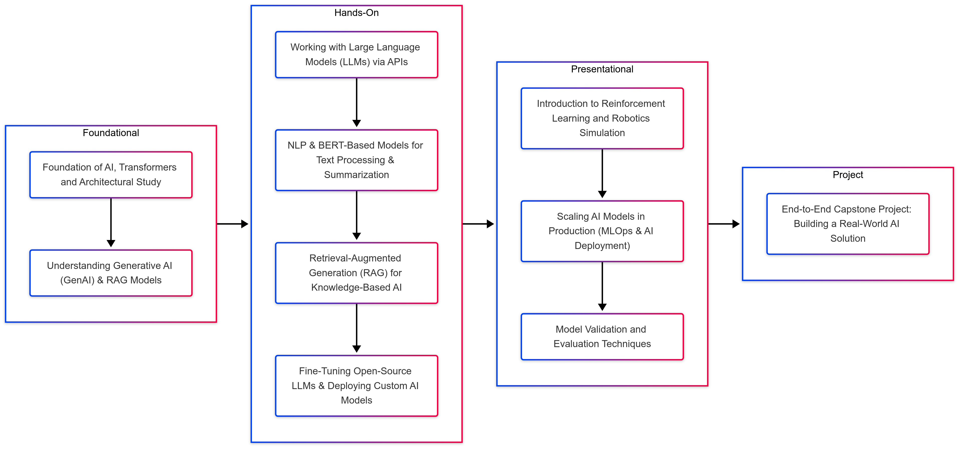
RoadMap – AI Foundational

Slide 24
Sessions | Main | Topics covered | Speaker name
1 | Foundation of AI, Transformers and Architectural Study | Understanding the core underlying architectures | Khushi
2 | Understanding Generative AI (GenAI) & RAG Models | Basics of GenAI, LLMs, embeddings, RAG principles. | Surya Kumari
3 | Working with Large Language Models (LLMs) via APIs | Calling LLM APIs, fine-tuning prompts, optimizing queries. | Khushi
4 | NLP & BERT-Based Models for Text Processing & Summarization | Text classification, named entity recognition (NER), summarization, Q&A. | Khushi
5 | Retrieval-Augmented Generation (RAG) for Knowledge-Based AI | Setting up vector stores, embedding retrieval, advanced RAG workflows. | Neha Mittal and Khushi
6 | Fine-Tuning Open-Source LLMs & Deploying Custom AI Models | Customizing AI models for domain-specific applications. | Neha Mittal and Khushi
7 | Introduction to Reinforcement Learning and Robotics Simulation | Using Open AI’s Gym and other simulation Libraries | Khushi
8 | Scaling AI Models in Production (MLOps & AI Deployment) | Automating model deployment, retraining, and real-time monitoring. | Rajesh
9 | Model Validation and Evaluation Techniques |  | --
10 | End-to-End Capstone Project: Building a Real-World AI Solution | Developing a fully functional AI system using learned techniques. | Khushi
11

Slide 25
Conclusion
By the end of this training, participants will:
Gain hands-on experience in building, fine-tuning, and deploying AI models.
Learn to work with LLMs, vector databases, and RAG workflows.
Be able to train custom AI models and optimize prompts for various applications.
Apply their skills in a real-world AI capstone project.

Slide 26

Introduction to AI
Manashi
Evolution of AI: Historical timeline and milestones.
AI Before and After LLMs
Why AI Is for Everyone
General ML/DL vs AI
AI Trends Across Industries
Platforms for Non-Tech Users
Getting Started as a Non-Tech Professional
Data Analytics and Visualization
Data Engineering for AI
The Future of AI
AI touches every profession, industry, and even personal productivity. Whether you’re a teacher customizing lesson plans or a marketer using AI to analyze trends, there’s something for everyone.

Slide 27
Evolution of AI: Historical timeline and milestones.
Manashi
2020s: Generative AI (GenAI), Retrieval-Augmented Generation (RAG), and Agentic AI.
Today - Hybrid AI: AI combined with sensors and IoT creating ubiquitous autonomous systems. For example, autonomous vehicles using AI alongside LiDAR and GPS sensors.
1950s-80s: Early AI systems – Rule-based systems and symbolic reasoning.
1990s-2000s: Machine Learning (ML) emergence – Algorithms trained on structured data.
2010s: Deep Learning (DL) and Neural Networks revolutionizing industries.
STEP 3
FUTURE STATE
STEP 2
CURRENT STATE
STEP 1
Notes:
In 1997, IBM’s Deep Blue beat the world chess champion Garry Kasparov. At the time, it was seen as a monumental AI breakthrough. Today, we can play better chess with apps on our phones. Tesla's autopilot doesn’t just use AI—it integrates sensors, cameras, and IoT to navigate roads.AI adoption has grown 270% in businesses over the past four years (source: Gartner).

Slide 28
AI Before and After LLMs
Manashi
AI After LLMs:
AI Before LLMs:
Enhanced human-like understanding (e.g., ChatGPT).
Shift towards Agentic AI: Systems capable of autonomous decision-making (e.g., autonomous drones, robotic advisors).
Context-aware systems processing unstructured data, conversational AI (e.g., ChatGPT, Bard).
Focused on pattern recognition, structured data, and supervised learning.
Limited conversational abilities and creativity.
Rule-based AI handling structured data, used for specific tasks like fraud detection.
Notes:
Pre-LLMs was like a calculator; post-LLMs is like having a full-fledged assistant who understands and anticipates your needs.”
Ex - A retailer using LLMs to personalize customer shopping experiences, resulting in a 20% sales increase.

Slide 29
Why AI Is for Everyone – AI isn’t about replacing jobs—it’s about making our lives and work smarter
Manashi
Have you Noticed ?
AI is democratized: No longer limited to tech companies.
Everyday tools for non-tech users (e.g., Grammarly, Canva).
Empowers industries from education to logistics.
AI Seeping into Non-Tech Fields:
AI applications in content creation, marketing, logistics, and even agriculture.
Everyday tools like chatbots, recommendation engines, and virtual assistants empower non-tech professionals.
Why Everyone Can Benefit:
AI democratizes opportunities. For example:
Small businesses scaling using AI-driven insights.
Creative professionals enhancing output with tools like Canva and RunwayML.
Notes:
A small bakery owner in India used AI to predict demand and doubled her sales during holidays.
37% of companies use AI, but 63% of non-tech professionals don’t know where to start (McKinsey).

Slide 30
General ML/DL vs AI
Manashi
ML : Algorithms learning from data.
AI : The umbrella term that includes ML/DL and extends to reasoning, problem-solving, and creative tasks.
DL : Subset of ML using neural networks for complex tasks.
ML/DL: Models trained to perform specific tasks (e.g., Netflix recommendations).
AI: Broader intelligence, reasoning, and adaptation across domains (e.g., autonomous vehicles).
Notes:
In healthcare, ML predicts diseases from X-rays, while AI designs customized treatment plans for patients. Think of ML/DL as building blocks—AI is the architect who uses those blocks creatively.

Slide 31
AI Trends Across Industries
Manashi
Banking & Finance:
Healthcare:
E-commerce:
EdTech:
Adaptive learning platforms, virtual tutors, content curation for learners.
Recommendation engines, personalized marketing, AI-driven inventory management.
Predictive diagnostics, drug discovery, virtual health assistants.
Fraud detection, personalized financial planning using AI chatbots.
Banking: Fraud detection, credit risk modeling.
Healthcare: AI-based diagnostics, personalized medicine.
E-commerce: Chatbots, supply chain optimization.
EdTech: Virtual tutors, adaptive learning paths.
Notes:
Finance: AI identifies suspicious transactions within milliseconds.
EdTech: AI platforms create tailored learning experiences for students.

Slide 32
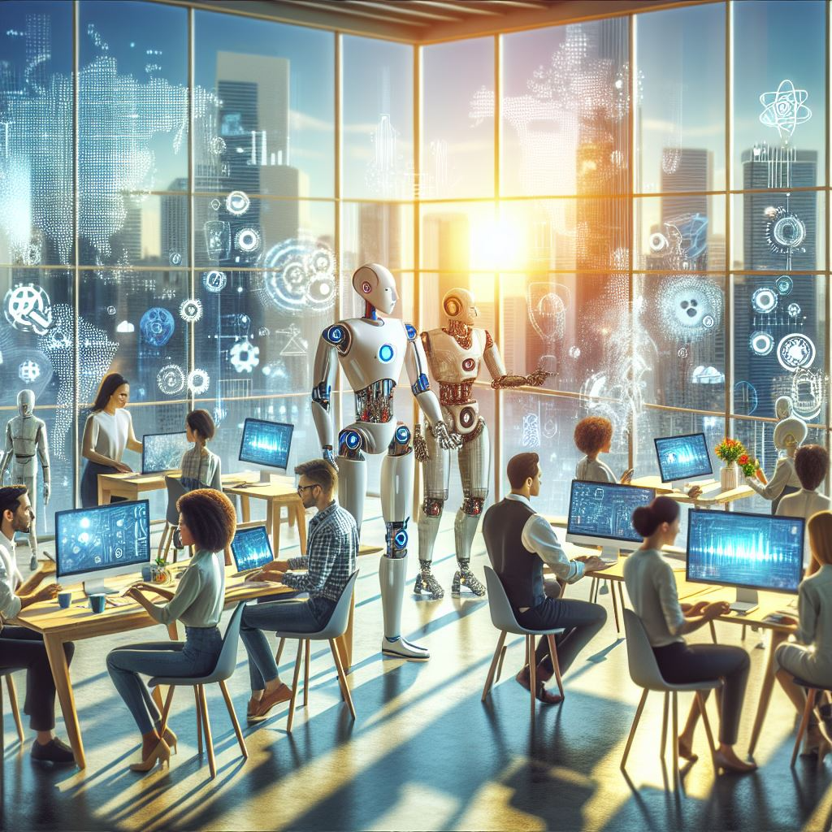
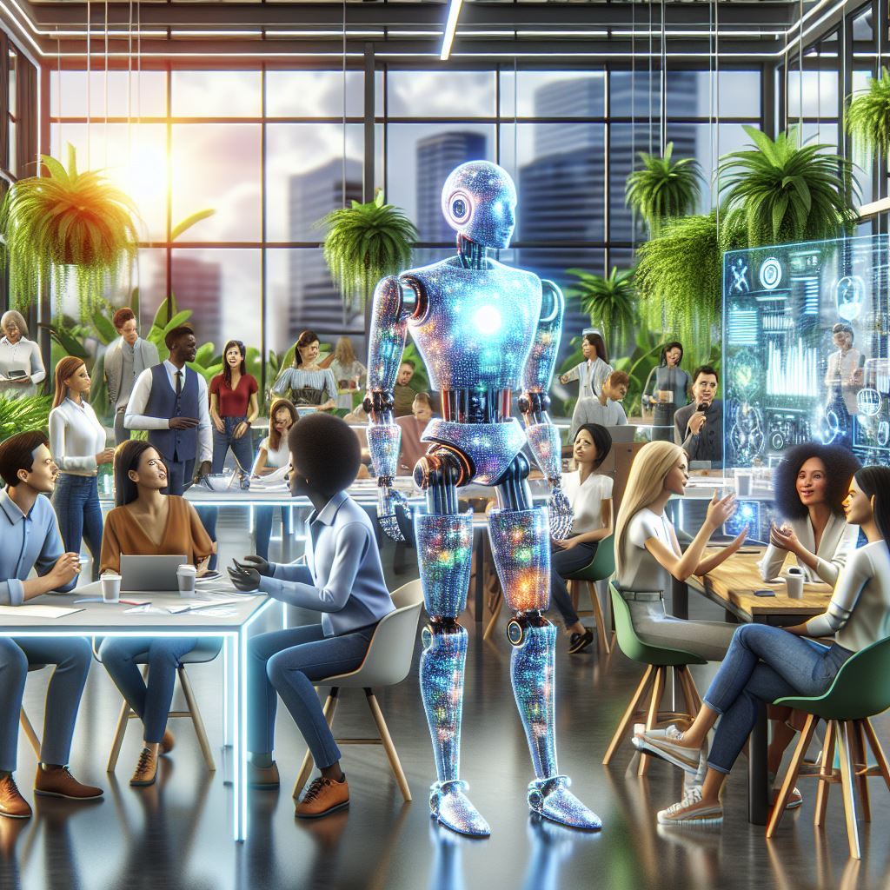
Closing Thought
Manashi
AI is the bridge between imagination and reality. Your role is to walk across that bridge and bring back value for your business, industry, or even personal growth
AI is no longer confined to coders and tech wizards. It’s a tool for everyone, from entrepreneurs to educators. The future belongs to those who can harness its power to create innovative solutions and transform industries.
Notes:
You don’t need to be an AI expert to use AI—start small, experiment, and watch how it transforms your world.

Slide 33
The Future of AI
Manashi
Key Points:
AI + IoT will power autonomous systems (e.g., self-driving cars, smart cities).
Ethics, sustainability, and personalization will shape AI’s growth.
Notes:
By 2030, AI will add $15.7 trillion to the global economy (PwC).
Visionary Insight: “Imagine farms where AI manages irrigation based on weather data—saving water and increasing yield. This isn’t science fiction; it’s happening now.”

Slide 34
AI Transformation
Reimagining Business Value

Slide 35
Leadership POV – AI Integration Strategy Intelligent Transformation, Not Disruption
Mapping AI to Existing Automation
Integrate AI within current workflows (e.g., RPA + AI for invoice processing).
Horizon 111 – Opportunities
10%
Transformational bets—pioneering AI solutions in new markets with new technology (e.g., exploring quantum ML or fully autonomous platforms).
Where to Play, How to Win
Core: Optimize existing products/services for existing customers using AI (e.g., predictive maintenance in manufacturing).
Adjacent: Expand AI solutions into “next to core” segments (e.g., a logistics firm using AI for last-mile delivery optimization).
Transformational: Develop breakthrough AI products for markets that don’t yet exist (e.g., VR-driven retail experiences).
Horizon 11 – Opportunities
20%
Adjacent growth—apply AI to new use cases or new markets adjacent to your core.
Knowledge of Market
70%
Incremental improvements using existing tech in existing markets (e.g., AI automation to reduce cost).
Horizon 1 – Opportunities
Knowledge of Technology
Notes:
A global consumer goods company used Horizon 1 AI to optimize supply chains (saving millions), while simultaneously investing in Horizon 3 AI for futuristic consumer experiences.
Key Principles-
Don’t Replace, Enhance: Use AI to empower talent.
Integrate, Not Implement: Align AI with existing business strategy—avoid siloed pilots.
Strategic Alignment: AI investments must tie directly to revenue growth, cost savings, or new market creation.

Slide 36
Non-tech Track – Speaker : Manashi
Session | AI Concepts | Use Cases & Business Impact | Challenges & Ethical Considerations
1 | Leadership POV – AI Integration Strategy | Strategic AI Integration Framework Where to Play, How to Win for Core, Adjacent, and Transformational AI Align AI with existing business strategy for ROI (e.g., cost reduction, new revenue) | Risk of siloed pilots if not integrated enterprise-wide Potential misalignment with strategic goals “Don’t Replace, Enhance” principle to mitigate workforce fears
2 | Workforce Transformation – AI & Human Collaboration | Reimagining Talent Strategy: AI literacy vs. deep tech skills New Role Archetypes: AI Prompt Engineers, AI Outcome Managers Tying AI skill shifts to Three Horizons (upskill for H1, R&D for H3) | Cultural resistance to AI adoption Potential bias in hiring/firing decisions if AI is misused Ongoing need for ethics & governance in HR-driven AI tools
3 | Productivity & Investment Landscape | Productivity Equation: 30–50% efficiency gains in knowledge work GE-McKinsey 9-Box for prioritizing AI investments Faster decision cycles & scalable AI-driven processes | High upfront investment ($500K–$5M) 80% AI project failure rate (change management) Ethical concerns (data privacy, AI bias lawsuits up 35%)
4 | Industry-Specific AI Use Cases & KPI Re-imagination | Financial Services: Fraud detection, real-time risk scoring Manufacturing: Predictive maintenance, downtime reduction Healthcare: Early disease detection, personalized care Retail: Dynamic pricing, AR/VR shopping | AI “black box” transparency issues Regulatory scrutiny (GDPR, HIPAA) Need for new KPIs & data governance frameworks
5 | AI Readiness Roadmap | Strategic Implementation: Current State Assessment, AI Capability Mapping Pilot Program Design: Horizon 1 quick wins vs. Horizon 2 & 3 R&D Scalable Implementation with feedback loops | Leadership commitment & cultural adaptability Ongoing AI governance to prevent misuse Ethical considerations in data usage & model bias
6 | The AI Transformation Promise | AI as Business Transformation, not just tech Three Horizons ensures balanced approach Doblin’s 10 Types of Innovation for holistic value creation | Over-reliance on AI can erode human oversight Maintaining a human-centric approach

Slide 37
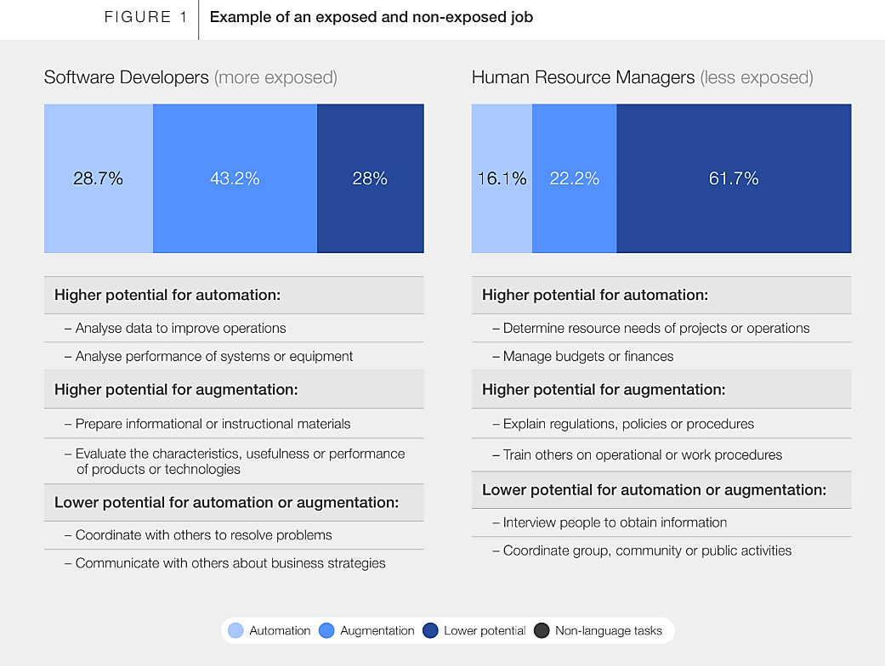
Workforce Transformation for AI and Human Collaboration Reimagining Talent Strategy
Skill Shift Dynamics
40% of current technical roles will be AI-augmented by 2026 (World Economic Forum).
Overall AI Literacy to precede before obtaining deep technical expertise.
New Role Archetypes: AI Prompt Engineers, AI Outcome Managers, AI-Assisted Strategy Consultants.
Human vs
AI Value Stream
AI Handles: Repetitive tasks, large-scale data crunching, 24/7 operations.
Humans Excel: Strategic decision-making, creative problem solving, relationship building.
Ref Source : World Economic Forum’s “Future of Jobs Report.
Notes:
A European bank combined AI chatbots with human advisors, cutting wait times by 60% while boosting customer satisfaction. So we need to encourage leaders to see AI as a “digital coworker,” not a threat.

Slide 38
Productivity & Investment Landscape The Productivity Equation
Potential Gains 30-50% efficiency improvement across knowledge work (BCG). AI shortens decision cycles by 37%, accelerating time-to-market.
Examples of Use Cases –
Box 1: AI-driven recommendation engine for retail and finance that tailors experiences in real time.
Box 2: Advanced analytics in manufacturing to predict equipment failures and optimize uptime.
Box 3: Integrating AI with remote diagnostic tools to offer personalized healthcare services and expand market reach.
Box 4: Combining robotic process automation (RPA) with predictive analytics to streamline back-office processes and reduce costs.
Box 5: Using AI to improve demand forecasting, inventory management, and logistics planning for a more resilient supply chain.
Box 6: Deploying entry-level AI chatbots to handle routine customer queries and enhance service availability.
Box 7: Leveraging AI for internal analytics in HR, finance, or operations to streamline processes and reduce manual overhead.
Box 8: Utilizing AI to monitor regulatory compliance and manage risks in real time within heavily regulated sectors.
Box 9: Implementing entry-level AI tools for automated data visualization and routine reporting to support decision-making.
Personalized Customer Experience Platform
AI-driven Predictive Maintenance
AI-Powered Telemedicine & Remote Patient Monitoring
AI-Powered Operational Efficiency
AI-Enhanced Supply Chain Optimization
Basic AI-Enabled Reporting & Dashboarding
Basic Chatbot for Customer Service
AI-Driven Internal Process Optimization
AI-Powered Compliance & Risk Monitoring
High
Medium
Industry Attractiveness
Low
High
Medium
Low
Competitive Strength of the Business Unit
Notes:
Box 1: Personalized Customer Experience Platform
Description: Leverages machine learning to offer dynamic, personalized recommendations across digital channels.
Business Impact: Drives increased customer engagement, higher conversion rates, and improved sales.
Ideal When: The market is highly attractive (e.g., competitive retail/finance sectors) and the organization possesses strong AI capabilities.
Box 2: AI-driven Predictive Maintenance
Description: Uses sensor data and advanced analytics to predict equipment failures in manufacturing.
Business Impact: Reduces downtime, lowers maintenance costs, and enhances overall productivity.
Ideal When: The manufacturing market is attractive, though the business unit’s current AI capability is moderate—suggesting further upskilling may be beneficial.
Box 3: AI-Powered Telemedicine & Remote Patient Monitoring
Description: Integrates AI with remote diagnostic tools to offer personalized healthcare services.
Business Impact: Opens new revenue streams, improves patient care, and increases market reach in healthcare.
Ideal When: The healthcare market is booming, but the organization may need to build or partner to bolster its AI expertise.
Box 4: AI-Powered Operational Efficiency
Description: Combines robotic process automation (RPA) with predictive analytics to streamline back-office functions.
Business Impact: Generates consistent cost savings and improves decision-making speed.
Ideal When: The market attractiveness is moderate, but the company already has strong internal operational capabilities.
Box 5: AI-Enhanced Supply Chain Optimization
Description: Uses AI to optimize demand forecasting, inventory management, and logistics planning.
Business Impact: Reduces waste, lowers inventory costs, and increases supply chain resilience.
Ideal When: The opportunity is moderately attractive, and the business unit has a reasonable foundation in data analytics and AI.
Box 6: Basic Chatbot for Customer Service
Description: Implements an AI-driven chatbot to handle frequently asked questions and basic customer interactions.
Business Impact: Enhances customer support availability and reduces operational workload, though it’s a more commoditized solution.
Ideal When: The market is moderately attractive, yet the organization is still building up its AI maturity.
Box 7: AI-Driven Internal Process Optimization
Description: Deploys AI for internal analytics in HR, finance, or operations to streamline processes and reduce costs.
Business Impact: Improves internal efficiencies and reduces manual overhead without necessarily driving new revenue.
Ideal When: The focus is on internal optimization (lower market attractiveness), and the organization is strong in AI deployment internally.
Box 8: AI-Powered Compliance & Risk Monitoring
Description: Uses AI to monitor regulatory compliance and manage risk in real time, especially in heavily regulated sectors.
Business Impact: Minimizes compliance risks and improves reporting accuracy.
Ideal When: The market is less dynamic, but maintaining compliance is critical; the business unit’s strength is moderate.
Box 9: Basic AI-Enabled Reporting & Dashboarding
Description: Provides entry-level data visualization and reporting using AI tools to automate routine analysis.
Business Impact: Offers operational insights but with limited strategic differentiation.
Ideal When: Both market attractiveness and business unit strength are low—this is a stepping stone initiative for broader AI maturity.

Slide 39
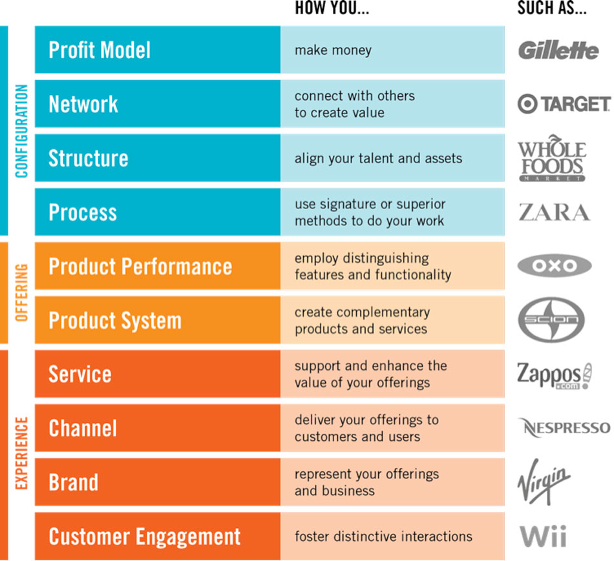
Industry-Specific AI Use Cases & KPI Reimagination Sector-Wise AI Transformation
Financial Services
Predictive Risk Management, Fraud Detection
New KPI: Real-time Risk Scoring
Process Innovation : Automating loan approvals for faster turnaround.
Manufacturing
Predictive Maintenance, Supply Chain Optimization
New KPI: Downtime Reduction
Configuration Innovation: Using AI to redesign supply networks.
Healthcare
AI Diagnostic Support, Patient Care Personalization
New KPI: Early Disease Detection Rates
Service Innovation: Telemedicine platforms powered by AI triage.
Retail
Personalized Recommendation Engines, Dynamic Pricing
New KPI: Basket Value Prediction
Experience Innovation: Immersive AI-driven shopping experiences (AR/VR).
Ref Source : Doblin (Deloitte) “10 Types of Innovation” framework
Notes:
Integrating Doblin’s 10 Types of Innovation: Configuration: Business model, network, structure, and process.
Offering: Product performance and product system.
Experience: Service, channel, brand, and customer engagement.
AI can enhance each dimension—e.g., using advanced analytics (Process), building new revenue streams (Business Model), or offering a more engaging Customer Experience.

Slide 40
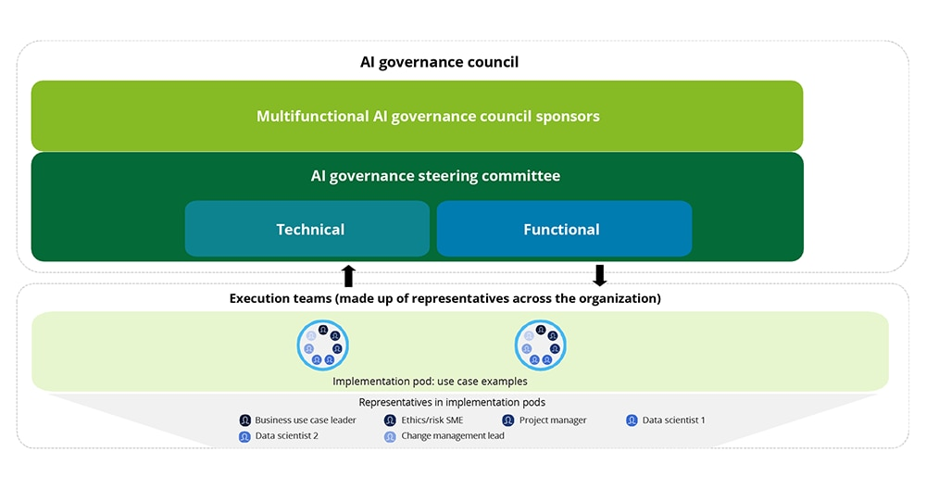
AI Readiness Roadmap Strategic Implementation Approach
AI Capability Mapping
Evaluate Where to Play, How to Win in core vs. adjacent vs. transformational spaces.
Pilot Program Design
Focus on quick wins in Horizon 1 for immediate ROI.
Explore Horizon 2 & 3 pilots with separate R&D budgets.
Scalable Implementation
Integrate proven pilots across global operations.
Continuously refine with Doblin’s 10 Types lens to find new innovation angles.
Continuous Learning & Optimization
Set up feedback loops to measure KPIs (e.g., cost savings, revenue growth, NPS).
Maintain an AI “Center of Excellence” for governance and skill-building.
Notes:
Highlight how a major consumer goods company used a 3-step pilot approach: Minimal viable product in one region.
Scale across multiple markets.
Integrate into enterprise architecture.

